Slide 1
Employee Data Analysis using Excel
STUDENT NAME : GOMATHI R
REGISTER NO : E22AF068
DEPARTMENT : ACCOUNTING & FINANCE
COLLEGE : PATRICIAN COLLEGE OF ARTS AND SCIENCE

Slide 2
PROJECT TITLE
Employee Performance Analysis using Excel

Slide 3


AGENDA
Problem Statement
Project Overview
End Users
Our Solution and Proposition
Dataset Description
Modelling Approach
Results and Discussion
Conclusion
3/21/2024 Annual Review

Slide 4

PROBLEM STATEMENT
The project involves creating an Excel-based tool for comprehensive employee data analysis. This tool will consolidate various employee data points, such as demographics, job roles, tenure, and performance metrics, into a structured format. By utilizing Excel's capabilities, including pivot tables, charts, and advanced formulas, the tool will allow users to analyze and visualize trends, patterns, and key metrics within the workforce.The primary objectives are to:
Facilitate the identification of trends and insights related to employee demographics, tenure, and performance.
Support HR in workforce planning, diversity initiatives, and employee retention strategies.
Provide a user-friendly interface for data-driven decision-making, enabling HR professionals and managers to make informed choices about employee development and organizational efficiency.This project will result in a versatile, easy-to-use tool that empowers stakeholders to leverage employee data effectively for strategic planning and operational improvement.

Slide 5

PROJECT OVERVIEW
.
Develop an Excel-based solution to analyze employee data, focusing on key metrics such as demographics, tenure, job roles, and performance.

Slide 6

WHO ARE THE END USERS?
The end users of the Excel-based employee data analysis tool are primarily:1. *Human Resources (HR) Professionals*: To monitor workforce metrics, develop retention strategies, and support diversity and inclusion initiatives. 2. *Managers and Team Leaders*: To assess team performance, identify areas for development, and make informed decisions on promotions, training, and resource allocation. 3. *Executives and Senior Management*: To gain insights into overall organizational health, track key performance indicators, and align HR strategies with business goals.4. *Data Analysts*: To further analyze employee data, create reports, and support HR with advanced data insights and trends.

Slide 7

OUR SOLUTION AND ITS VALUE PROPOSITION
Filtering – missing values
Conditional formatting – blank values
Pivot table
Chart

Slide 8
Dataset Description
Kaggle-employee data set
26 features
9 features
Employee id –numerical
Gender-male, female
Business unit
Employee type
Status
Performance
Rating –num
level

Slide 9

THE "WOW" IN OUR SOLUTION
The "WOW" factor in our Excel-based employee data analysis tool lies in its ability to transform complex, disparate employee data into actionable insights through an intuitive and user-friendly interface. Key highlights include:1. *Interactive Dashboards*: Dynamic, visually appealing dashboards that allow users to instantly visualize key metrics, such as turnover rates, diversity statistics, and performance trends, making data-driven decisions easier and faster.2. *Automated Reporting*: The tool offers automated, customizable reports that update in real-time as new data is entered, saving time and reducing manual errors, while providing consistently up-to-date insights.3. *Advanced Data Analysis*: Leverage Excel's powerful features, such as pivot tables, slicers, and conditional formatting, to drill down into specific data segments, identify patterns, and uncover hidden insights that might be missed with traditional analysis.
3/21/2024 Annual Review
9

Slide 10
MODELLING
Data collection
Data cleaning- filtering
Performance level
Piot table
Graph
10

Slide 11
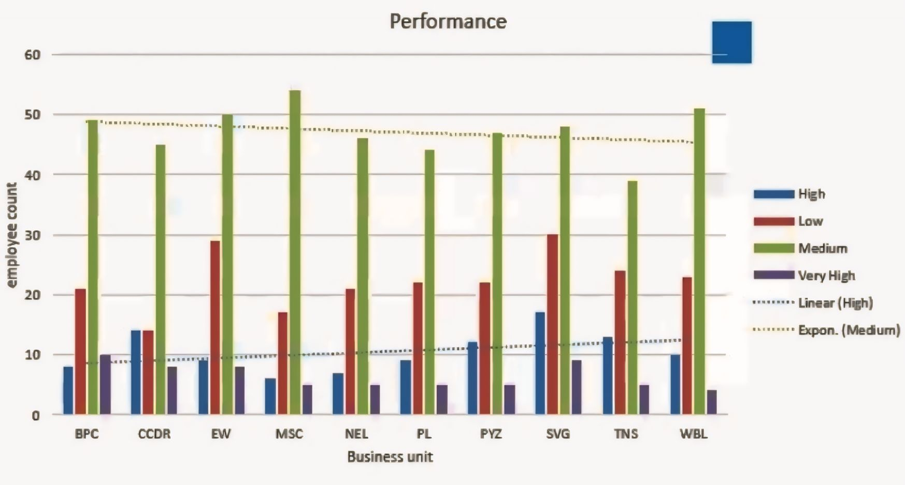
RESULTS
11

Slide 12
conclusion
In conclusion, our Excel-based employee data analysis tool offers a powerful, user-friendly solution that transforms raw employee data into meaningful insights. By integrating advanced data visualization, automated reporting, and predictive analytics, the tool empowers HR professionals, managers, and executives to make informed, data-driven decisions that enhance workforce planning, improve employee retention, and support organizational growth. Its scalability and flexibility ensure that it remains a valuable asset as the organization evolves, making it an indispensable resource for optimizing employee management and driving overall business success.

